Slide 1

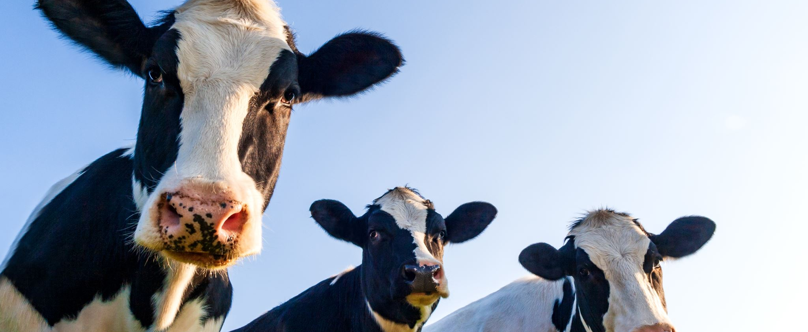





CATTLE MANAGEMENT SYSTEM IRAJ PUDASAINI s4647978 BRIJESH SONI s4649575 ROHAN SHRESTHA s4632768 Group 6

Slide 2
Introduction
These days, the role that technology plays in practically every facet of life
Even more significantly, the agricultural sector is essential to the functioning of almost every other sector of the economy
This technique may be used to produce milk as well as a variety of dairy products

Slide 3
Aim & Objective
To find out the proper working of the cattle management system that is made.
To see if there are any sort of problems with the cattle management system that has been developed.
To do an in-depth analysis of the software work that is related to the developed cattle management system.

Slide 4
Background of the study
In the course of putting this novel approach to cow management into practice
When the only tools that were accessible were copies and regular exercise books
Over the last several decades, there has been a significant increase in both the amount of food that is consumed

Slide 5
Method
the fundamental objective of the whole endeavour is to provide assistance
The technique for the creation of the system is based on the framework
The student group working on this programme will be making a continuous plan in order to construct it
We have educated ourselves on the necessary programming languages, such as HTML, CSS, and PHP, in order to create this application. These languages are essential

Slide 6
Resource Requirement
Some of the requirements are unquestionably necessary,
There are certain criteria that need to be met for the programme to operate correctly, and these requirements are imposed on both the hardware and the software
software designers need to be conversant in at least one sort of programming language

Slide 7
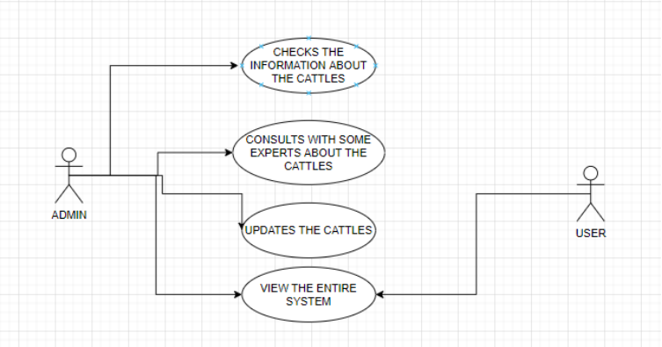
Use Case Diagram

Slide 8
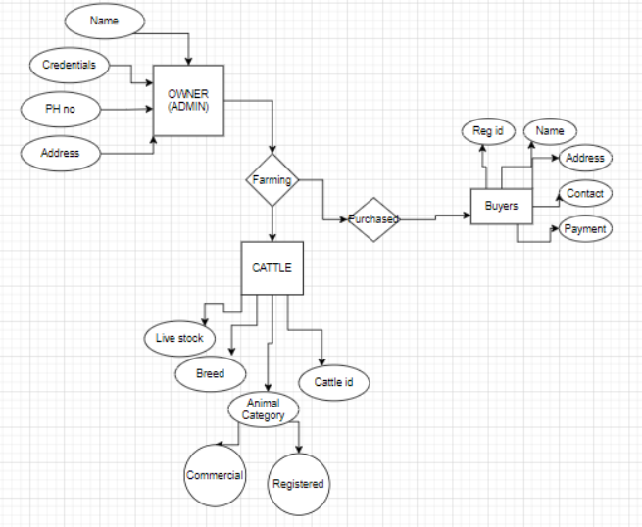
ER Diagram

Slide 9
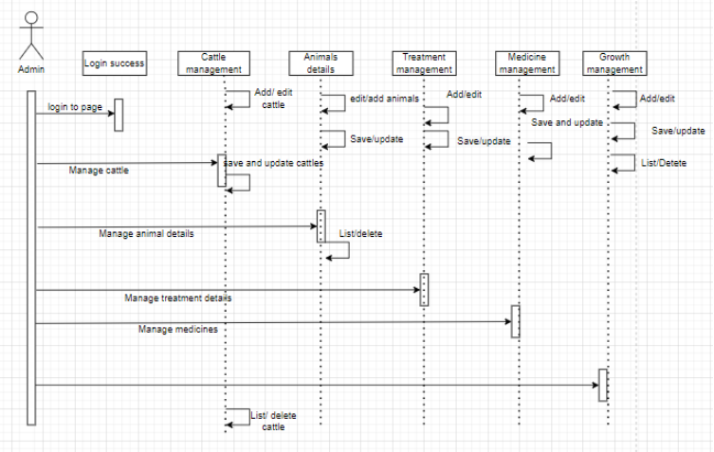
Sequence diagram

Slide 10
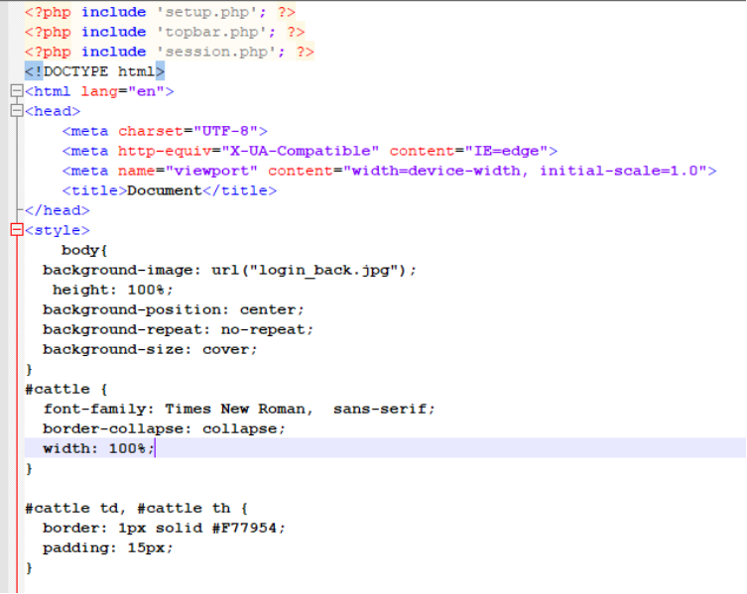
Dashboard coding part

Slide 11
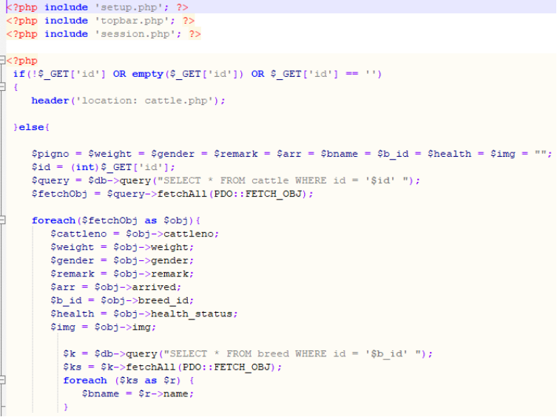
Coding part of edit cattle

Slide 12
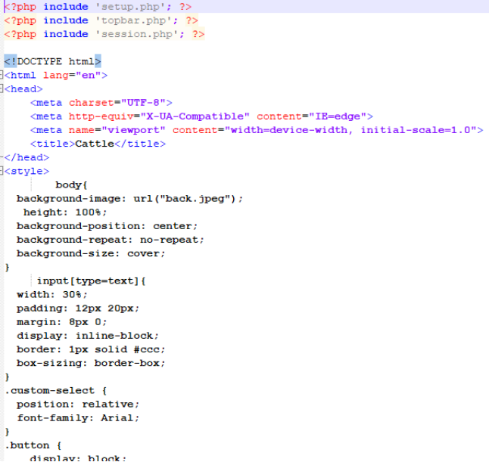
Cattle insert coding part

Slide 13
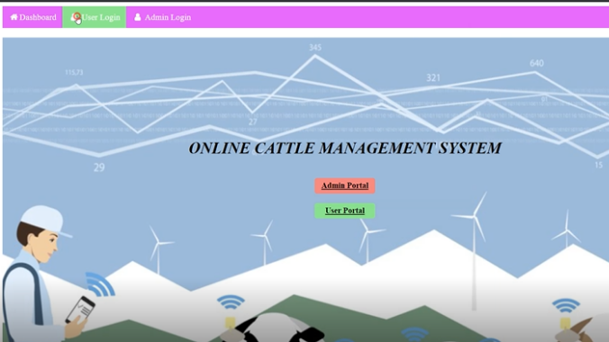
Dashboard output

Slide 14
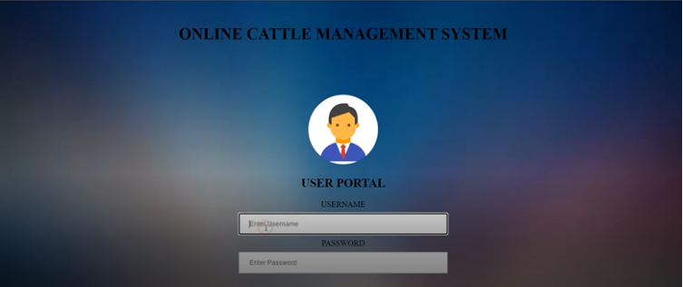
User portal login

Slide 15
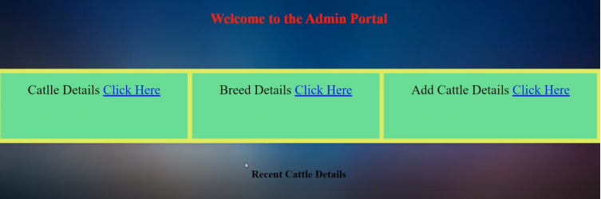
Admin portal login

Slide 16
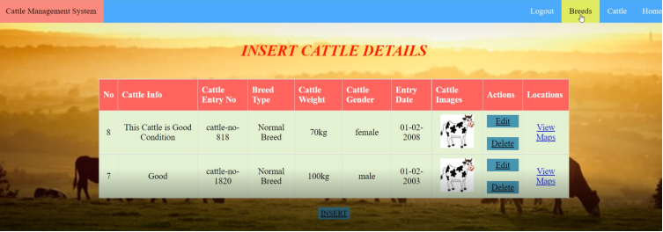
Cattle details insert

Slide 17
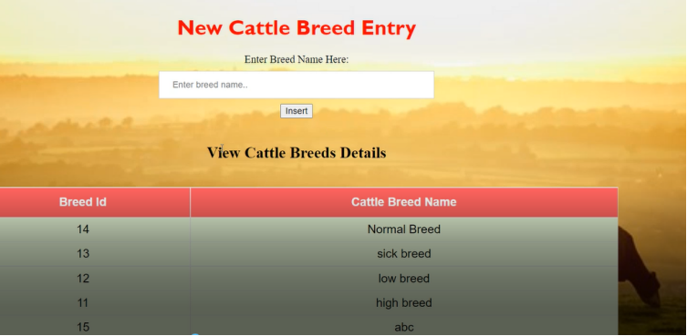
New cattle breed entry

Slide 18
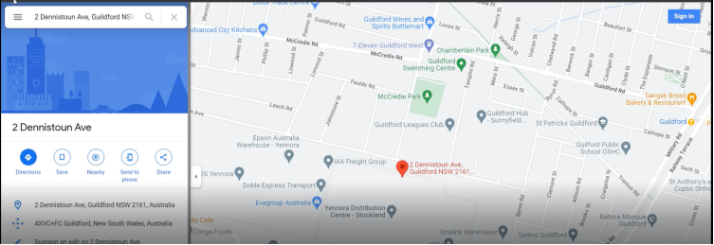
Map View

Slide 19
Discussion
The creation of an automated livestock management system was the primary objective of this project.
As a consequence of this, the researchers have devised a strategy to assist farmers in this predicament by offering them apps of this sort as well as others that are pretty comparable to the one being discussed here.
The application may be broken down into two distinct categories: the first category is reserved for program managers,

Slide 20
ANALYSIS
The standard PHP connection was used throughout the whole process of developing and implementing the database.
It was cleaned up after all of the code files had been finished, after all of the CSS and HTML files had been implemented
This website has the potential to play a significant role in the business of cattle because it has the potential to play a significant role

Slide 21
Future Scope
The researchers have produced a fantastic application that is really exceptional in terms of the breadth of its reach and the depth of its accomplishments.
This PHP-based application is compatible with any kind of management system that you could possibly imagine using.
The cloud computing infrastructure might be used to establish a connection for this application. This suggests that the application may be used from any area at any time so long as there is a connection to the internet accessible to do so

Slide 22
Recommendation
Other programming languages, such as HTML, CSS, PHP, and JavaScript, have been used in the completion of particular duties that are necessary.
It is possible to supply some improved ideas about the application in order to make the process of performing research a technique that is both more effective and takes less time
The cloud infrastructure will be considerably more secure and will not have any worries with data leaking, despite the fact that it will be less costly to monitor everything and every detail.

Slide 23
Conclusion
A cattle management system for tracking the live stocks that are present within a farm
After the deployment of this cattle management system that is planned for this project
If the administrator of the Cattle Management System uses the findings of this research or the product of this application,

Slide 24
Reference List
Kasem, S., Saleh, M., Qasim, I., Hashim, O., Al Karar, A., Abu‐Obeida, A., Gaafer, A., Hussien, R., AL‐Sahaf, A., Al‐Doweriej, A. and Bayoumi, F., 2018. Outbreak investigation and molecular diagnosis of lumpy skin disease among livestock in Saudi Arabia 2016. Transboundary and emerging diseases, 65(2), pp.e494-e500.
Kelley, J.M., Rathinasamy, V., Elliott, T.P., Rawlin, G., Beddoe, T., Stevenson, M.A. and Spithill, T.W., 2020. Determination of the prevalence and intensity of Fasciola hepatica infection in dairy cattle from six irrigation regions of Victoria, South-eastern Australia, further identifying significant triclabendazole resistance on three properties. Veterinary Parasitology, 277, p.109019.
Kovácsné Koncz, N., Béri, B., Deák, B., Kelemen, A., Tóth, K., Kiss, R., Radócz, S., Miglécz, T., Tóthmérész, B. and Valkó, O., 2020. Meat production and maintaining biodiversity: Grazing by traditional breeds and crossbred beef cattle in marshes and grasslands. Applied Vegetation Science, 23(2), pp.139-148.
Madushanka, R., Wirasagoda, H. and Halgamuge, M., 2019. Adoption of the Internet of Things (IoT) in agriculture and smart farming towards urban greening: A review.
Martinez, C.C., Maples, J.G. and Benavidez, J., 2021. Beef cattle markets and covid‐19. Applied Economic Perspectives and Policy, 43(1), pp.304-314.
MEHTA, D.N.K., 2018. 1. PREVALENCE OF ECTOPARASITE INFESTATIONS ON CATTLE IN AMRELI DISTRICT WESTERN INDIA by DR. NIMESH K. MEHTA. LIFE SCIENCES LEAFLETS, 100, pp.1-to.
Meshesha, D.T., Mohammed, M. and Yosuf, D., 2019. Estimating carrying capacity and stocking rates of rangelands in Harshin District, Eastern Somali Region, Ethiopia. Ecology and Evolution, 9(23), pp.13309-13319.
Munidasa, S., Eckard, R., Sun, X., Cullen, B., McGill, D., Chen, D. and Cheng, L., 2021. Challenges and opportunities for quantifying greenhouse gas emissions through dairy cattle research in developing countries. Journal of Dairy Research, 88(1), pp.3-7.

